Slide 1
Tanks 3D
Team Steel: Nick Furfari, Patrick McCleerey, David Atkins

Slide 2

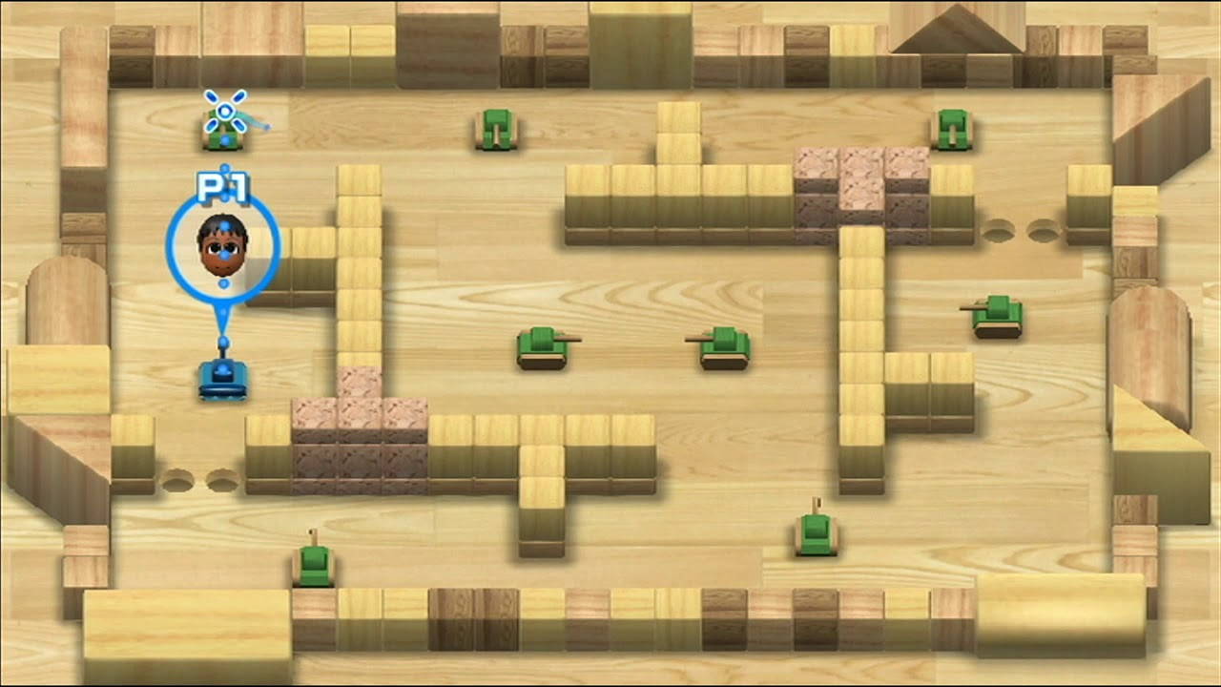
Inspiration
We are taking the multiplayer style of shellshock live and the gameplay and map layout of wii tanks.
Wii tanks

Slide 3
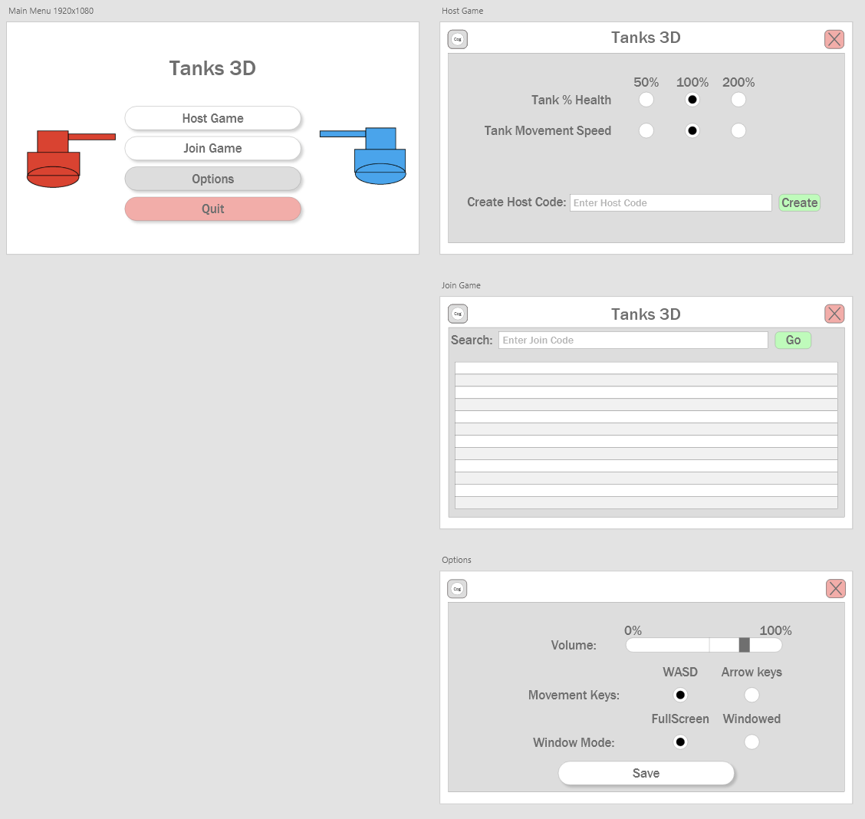
UI Mockup

Slide 4
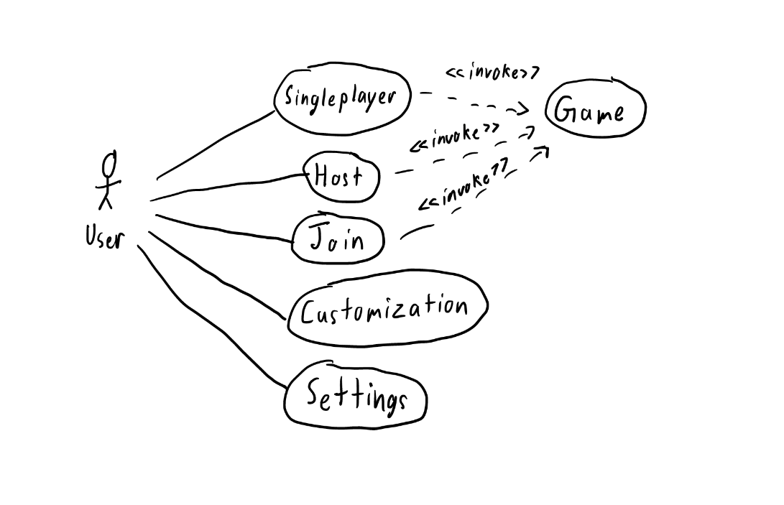
Use Case Diagram
Main use cases being Host or Join
Both invoke the Game scene
Singleplayer may or may not be implemented

Slide 5
Use Case Texts
Basic Course: Join
The system displays the main menu after loading the game. The User then clicks on Join lobby. The system then checks the user’s internet connection before going to the next menu. The system then displays the Join screen. The user can then join a lobby by using a join code. The user then displays the start game screen and both players load into the game.
Alternate Courses:
No internet: The user has tried playing multiplayer without a valid internet connection. The system displays a noInternetError and takes the user back to the main menu.
Invalid join key: The user has entered an invalid join key. The system then displays a InvalidJoinKeyError. The system then takes the user back to the Join game page.
User Leaves: When either user leaves the lobby is disbanded. All remaining users will be sent to the main menu with a Lobby Disbanded error message.
Basic Course: Host
The system displays the main menu after loading the game. The User then clicks Host lobby. The system then checks the user’s internet connection before going to the next menu. The system then displays the Host screen. The user is then shown there lobby code. When a user joins the lobby, the host will be notified. The system then displays a start game screen and both players load into the game.
Alternate Courses:
No internet: The user has tried playing multiplayer without a valid internet connection. The system displays a noInternetError and takes the user back to the main menu.
Invalid join key: The user has entered an invalid join key. The system then displays a InvalidJoinKeyError. The system then takes the user back to the Join game page.
User Leaves: When a user leaves the lobby is disbanded. All remaining users will be sent to the main menu with a Lobby Disbanded error message.

Slide 6
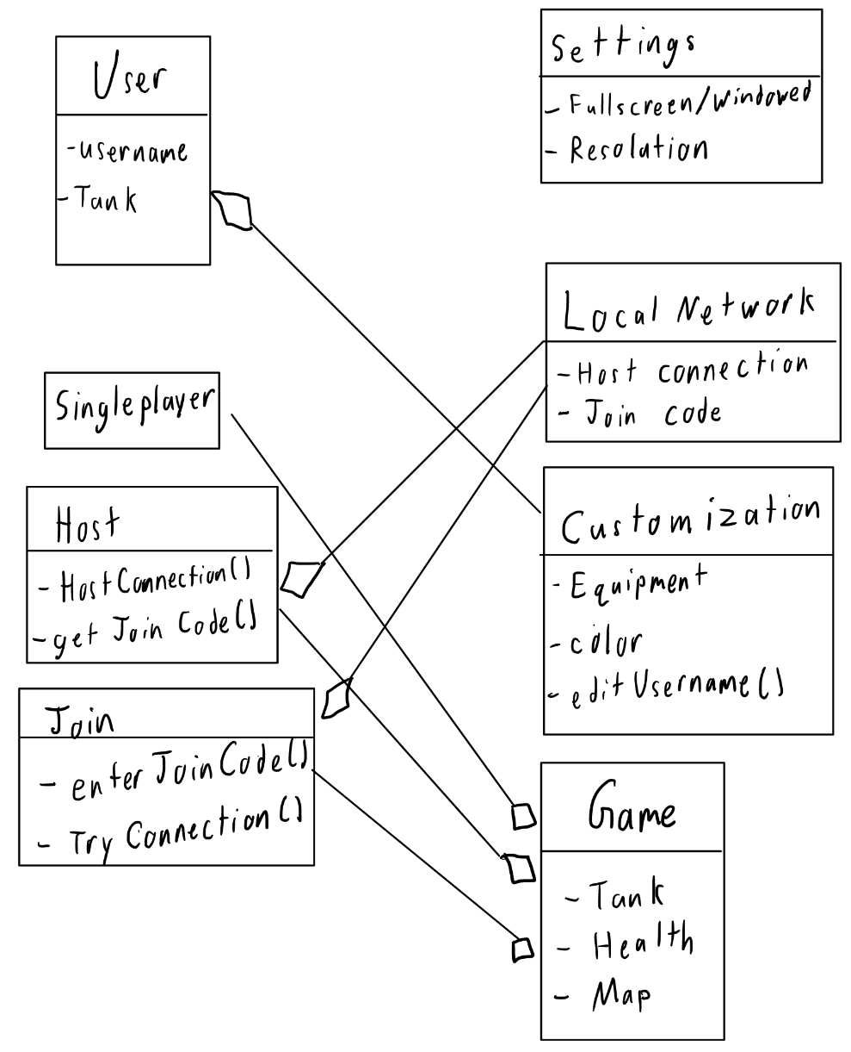
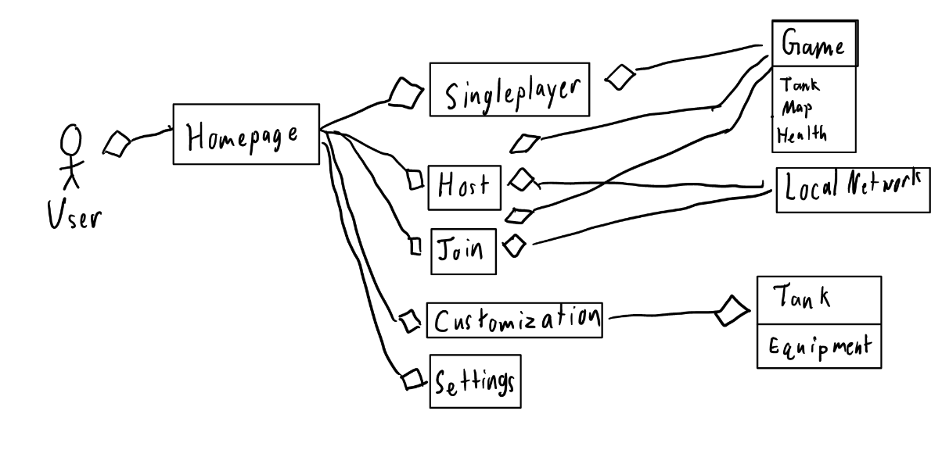
Class Diagram and Domain Model

Slide 7
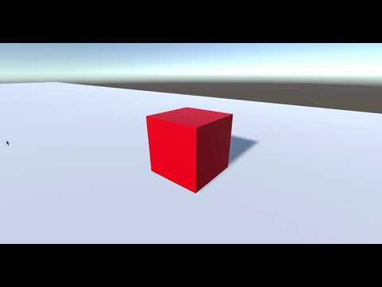
Implemented Features so far
Implemented 3rd camera movement
Camera still clips through walls
Implemented movement using the WASD keys

